Slide 1

E-commerce Backend System Using FastAPI Project Owner : Sahil Garg
Submitted by: Vibha Yadav Submitted to : Shantanu Bangar

Slide 2
Objective
The objective of this project is to design and implement a secure, scalable, and role-based backend system for an E-Commerce platform using FastAPI. The system enables:
Admin product management (CRUD)
User authentication (signup, signin, forgot password, reset password)
Product browsing (listing, search, detail view)
Shopping cart and dummy checkout
Order history and details

Slide 3
Tech Stack
FastAPI (Backend Framework)
SQLAlchemy (ORM)
SQLite (Database)
JWT (Authentication)
Pydantic (Validation)

Slide 4
Key Features
User Registration & Login with JWT
Role-Based Access Control (Admin/User)
Product CRUD (Admin)
Public Product Listing with Filters
Cart Operations
Checkout & Order History

Slide 5
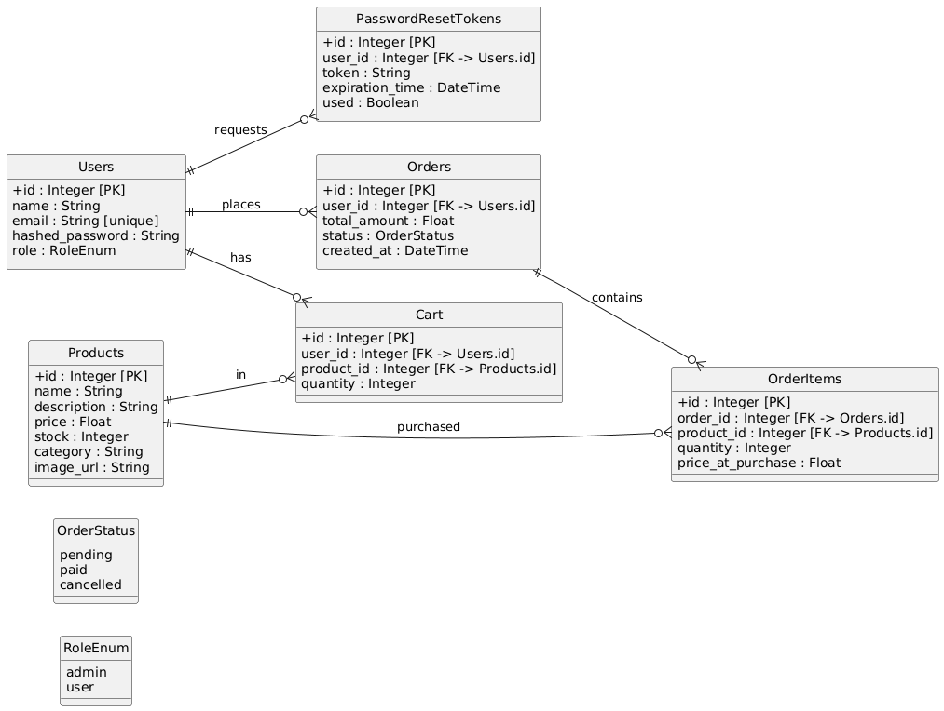
ER Diagram

Slide 6
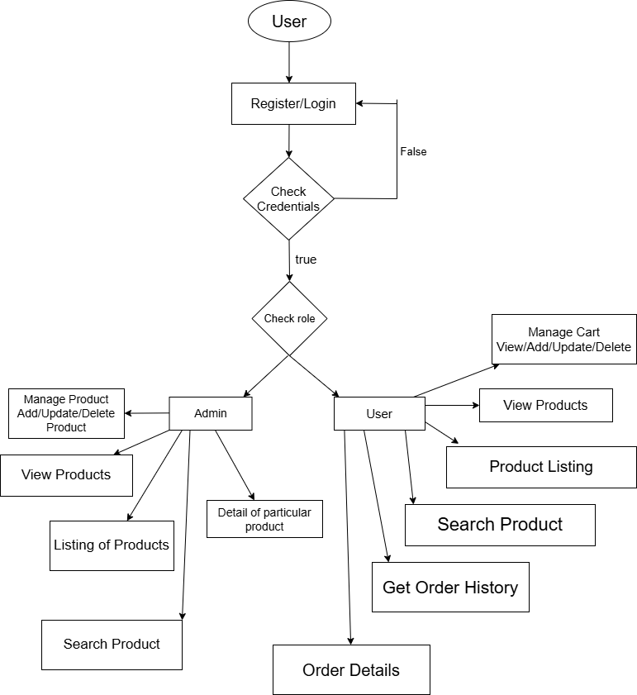
Flow Chart

Slide 7
API Endpoint
Authentication and User Management
User Signup
Endpoint: POST /auth/signup
User Signin
Endpoint: POST /auth/signin
User Role
Endpoint: POST /auth/me
Forgot Password
Endpoint: POST /auth/forgot-password
Reset Password
Endpoint: POST /auth/reset-password

Slide 8
API Endpoint
Admin Product Management (CRUD
Create Product
Endpoint: POST /admin/products
Read Product List
Endpoint: GET /admin/products
Read Product Details
Endpoint: GET /admin/products/{id}
Update Product
Endpoint: PUT /admin/products/{id}
Delete Product
Endpoint: DELETE /admin/products/{id

Slide 9
API Endpoint
Public Product APIs
Product Listing
Endpoint: GET /products
Product Search
Endpoint: GET /products/search
Product Detail View
Endpoint: GET /products/{id}

Slide 10
API Endpoint
Cart Management
Add to Cart
Endpoint: POST /cart
View Cart
Endpoint: GET /cart
Remove from Cart
Endpoint: DELETE /cart/{product_id}
Update Quantity
Endpoint: PUT /cart/{product_id}

Slide 11
API Endpoint
Checkout
Dummy Payment
Endpoint: POST /checkout
Orders and Order History
View Order History
Endpoint: GET /orders
View Order Details
Endpoint: GET /orders/{order_id}

Slide 12
Thank You Journey Begins…

